Slide 1
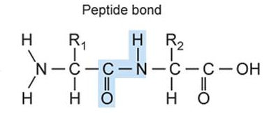
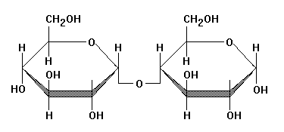
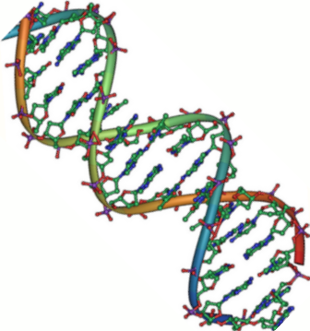
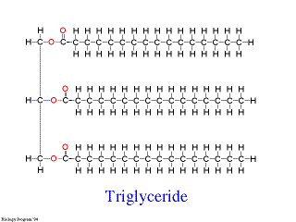
Macromolecules

Slide 2
Biology Warm up
Proteins are made up of what monomer?
Is a monomer one or many?
What substance would be an important medium for chemical reactions in your body? (Hint:What is your body mostly made up of?)

Slide 3
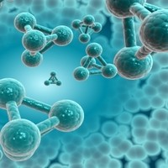
BIOMOLECULES
In biology, there are 4 important molecules for life, called biomolecules:
CARBOHYDRATES
LIPIDS
PROTEINS
NUCLEIC ACIDS

Slide 4
Polymers & Monomers
Most biomolecules are polymers.
A polymer is a large molecule made of smaller building blocks, called monomers.
Polymers are also called macromolecules.

Slide 5
Organic Compounds
These biomolecules are organic compounds, which means they contain the element carbon (C).
They also contain the elements hydrogen (H), nitrogen (N) and oxygen (O).

Slide 6
Carbohydrates
The main source of energy

Slide 7
Carbohydrates
STRUCTURE (CHO)
MONOMER:
Monosaccharide = 1 sugar
Examples: glucose
fructose
glucose

Slide 8
Carbohydrates
POLYMERS:
Disaccharide: 2 sugars
Examples:
sucrose
lactose
glucose
glucose

Slide 9
Carbohydrates
Polysaccharide: many sugar units
Examples: starch (bread, potatoes)
glycogen (beef, muscle)
cellulose (lettuce, corn)
glucose
glucose
glucose
glucose
cellulose
glucose
glucose
glucose
glucose

Slide 10
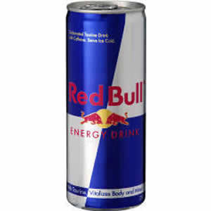
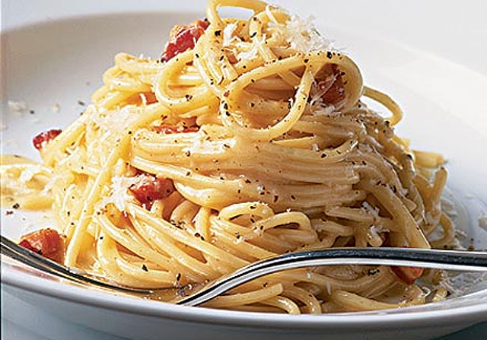
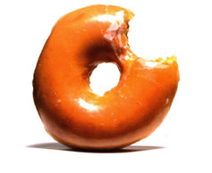
Carbohydrates
FUNCTIONS:
1. Short term energy storage

Slide 11
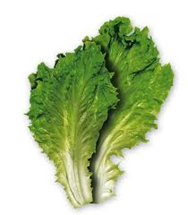
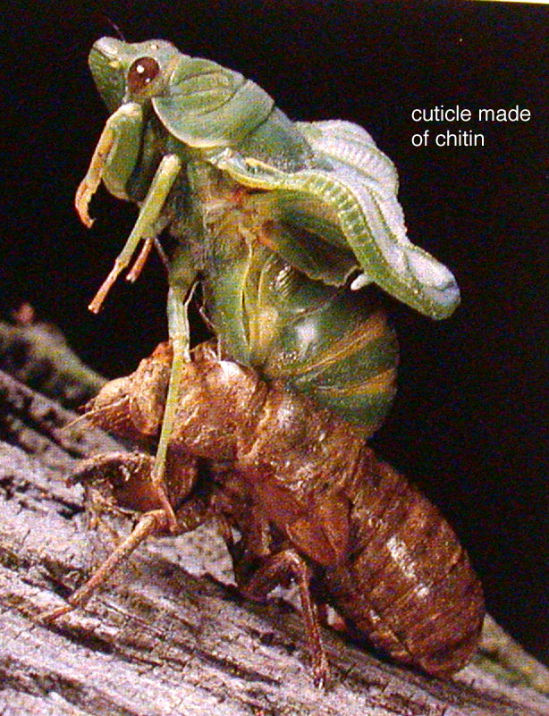
Carbohydrates
2. Structural support
a. Cellulose in plants
b. Chitin in animals (exoskeleton)

Slide 12
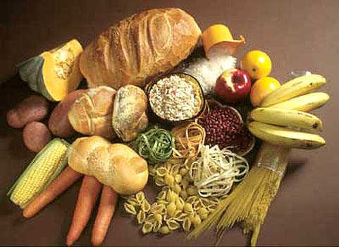
Carbohydrates

Slide 13
Lipids
Compounds that are not soluble in water

Slide 14
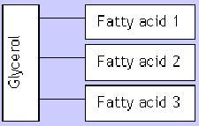
Lipids
STRUCTURE (CHO)
MONOMERS:
glycerol and fatty acids
POLYMER: triglyceride

Slide 15
Lipids
glycerol
3 fatty acids
H
H-C----O
H-C----O
H-C----O
H
O
C-CH₂-CH₂-CH₂-CH₂-CH₂-CH₂-CH₂-CH₂-CH₂-CH₃
=
O
C-CH₂-CH₂-CH₂-CH₂-CH₂-CH₂-CH₂-CH₂-CH₂-CH₃
=
O
C-CH₂-CH₂-CH₂-CH
=
=CH-CH₂-CH₂-CH₂-CH₂-CH₃

Slide 16
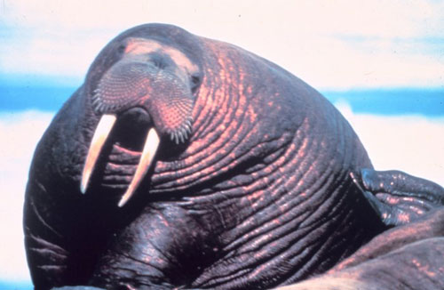
Lipids
FUNCTIONS:
1. Long term energy storage
2. Insulation (protection against heat loss
3. Protection (padding)
4. Prevent water loss

Slide 17
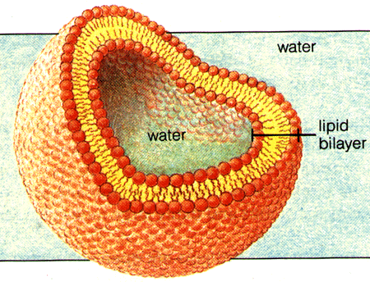
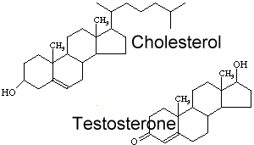
Lipids
5. Send chemical messages (steroids)
6. Major component of cell membrane (phospholipid)
Cell Membrane
Steroids

Slide 18
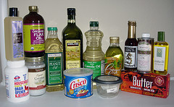
Lipids
Examples:
Fats
Oils
Waxes
Steroids

Slide 19
Proteins
The most diverse macromolecules

Slide 20
Proteins
STRUCTURE (CHON)
MONOMERS:
amino acids (20 different kinds)
POLYMER:
Polypeptide (protein)

Slide 21
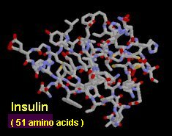
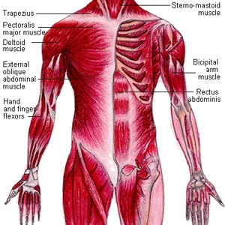
Proteins
FUNCTIONS:
1. Transport (hemoglobin in blood)
2. Regulate organs (hormones)
3. Form muscles

Slide 22
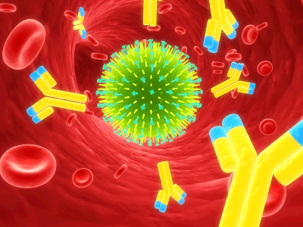
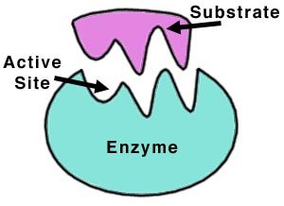
Proteins
4. Structure (hair, nails)
5. Control chemical reactions (enzymes)
6. Fight disease (antibodies)
Flu virus

Slide 23
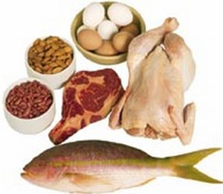
Proteins
Examples:
Meats
Beans
Nuts
Eggs

Slide 24
Nucleic Acids
A valuable source of information

Slide 25
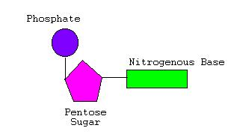
Nucleic Acids
STRUCTURE (CHONP)
MONOMER:
nucleotide
5 carbon sugar
Phosphate group
Nitrogenous base

Slide 26
Nucleic Acids
POLYMER:
Two types:
1. Deoxyribonucleic acid (DNA) 2. Ribonucleic acid (RNA)

Slide 27
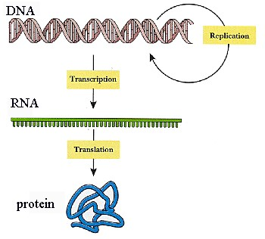
Nucleic Acids
FUNCTION:
Store and transmit genetic information

