Slide 1
Ecological Pyramids
WE WILL:
YOU WILL:

Slide 2
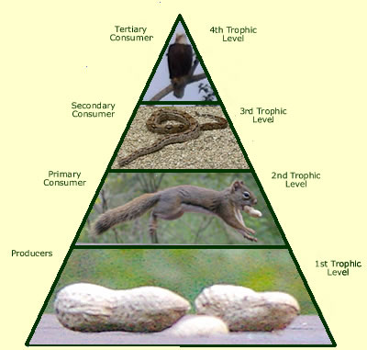
An ecological pyramid is a diagram that ______________________________________________
______________________________________________

Slide 3
An ecological pyramid is a diagram that shows the relative amount of energy or matter available at each trophic level of a food chain

Slide 4
Energy Pyramid – shows the amount of energy available at each trophic level.
Only 10% of the energy available within one trophic level is transferred to the next level.

Slide 5
Example – if the insects provide 1000 kcal of energy to the rodents, the rodents only get 100 kcal other 900 kcal was used by the insects for body processes such as breathing and some was lost as heat.

Slide 6
Lets practice together
If the grass contains 1600 kcal, how many kcal transfer to the grasshoppers?
160kcal

Slide 7
If the grass contains 900 kcal, how many kcal transfer to the grasshoppers?
How many kcal does the mouse receive from the grass?
90kcal
.9 kcal

Slide 8
If the rodents get 750 kcal, how many Calories did the grass contain?

Slide 9
If the rodents get 750 kcal, how many Calories did the insects contain?
4. How many calories did the grass contain?
7500 Calories
75,000 Calories

Slide 10
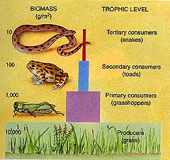
Biomass Pyramid
_______________________- represents the amount of living matter at each trophic level.

Slide 11
Biomass Pyramid
measured in g/m² or kg/m²
_________ usually account for the most biomass
Producers

