Slide 1
Eukaryotic Cell Cycle

Slide 2
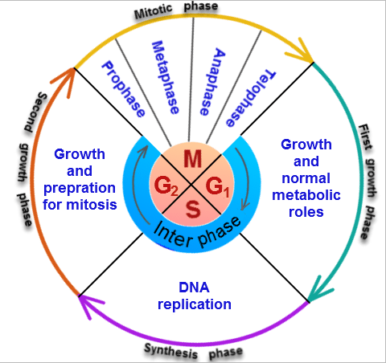
The Eukaryotic Cell Cycle
The cell cycle is when a cell grows, prepares for division, and divides into two new daughter cells.

Slide 3
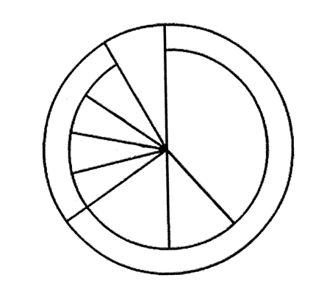
Three parts to the cell cycle:
Interphase
Mitosis
Cytokinesis

Slide 4
Interphase is divided into 3 parts:
G1 phase: Cells are growing. They get larger and make organelles
S phase: Synthesis. The cell replicated its DNA.
G2 phase: The cell prepares for cell division. Any needed organelles are made (centrioles).

Slide 5
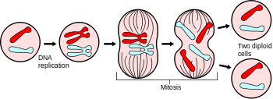
MITOSIS
Mitosis : Division of the nucleus

Slide 6
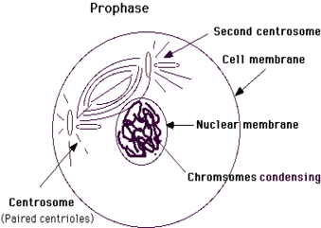
PROPHASE
Chromosomes become visible. The spindle starts to form between the centrioles. The nuclear membrane dissolves.

Slide 7
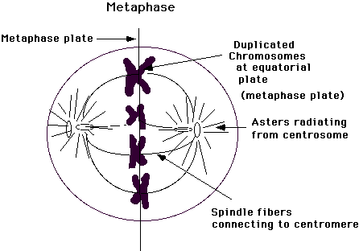
METAPHASE
The centromeres of the duplicated chromosomes line up across the middle of the cell.

Slide 8
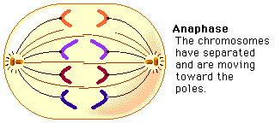
ANAPHASE
The duplicated chromosomes begin to separate. They pulled apart by the spindle fibers and move to opposite sides of the cell.

Slide 9
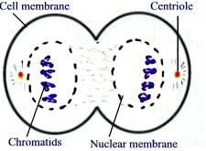
TELOPHASE
The chromosomes become less distinct and the new nuclei begin to form.

Slide 10
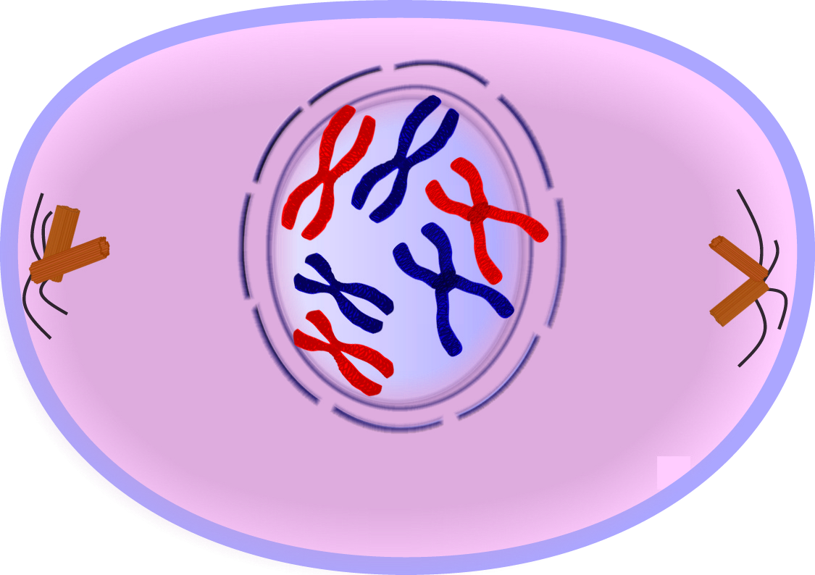

Slide 11
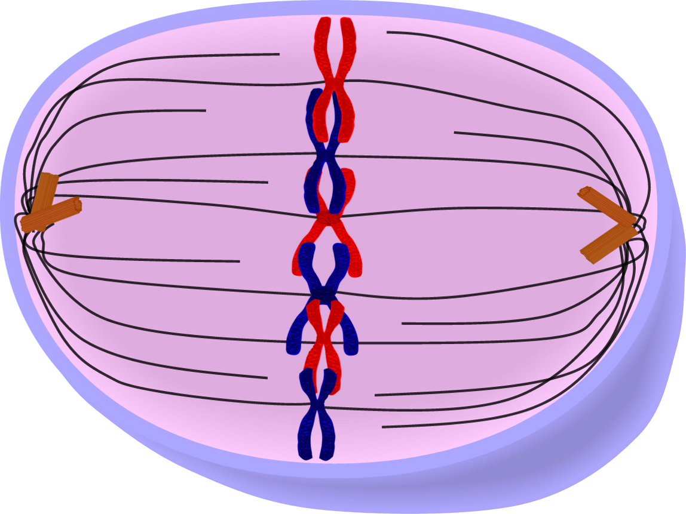

Slide 12
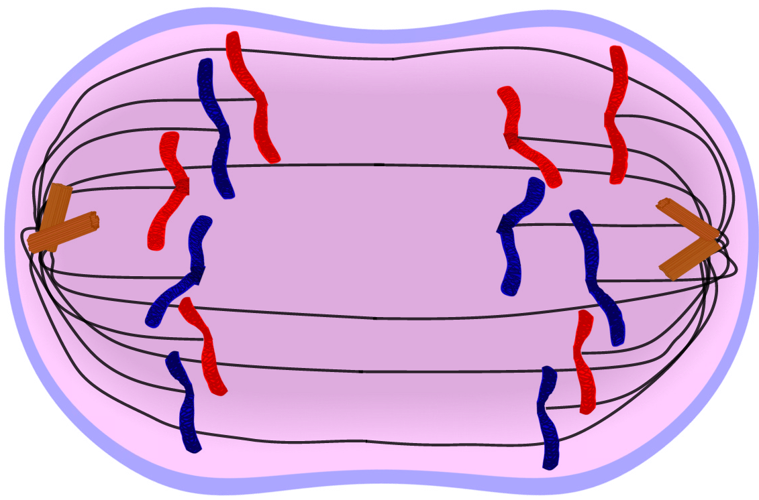

Slide 13
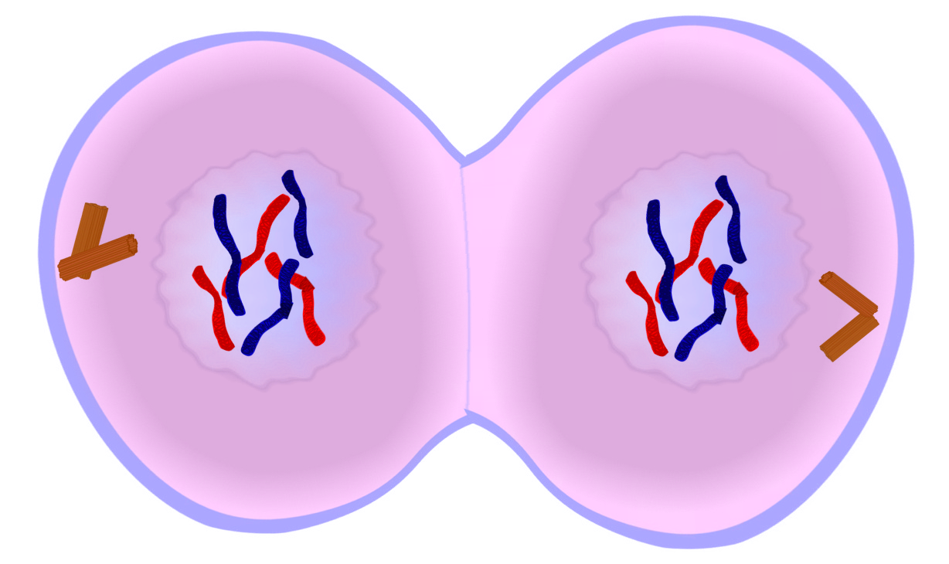

Slide 14
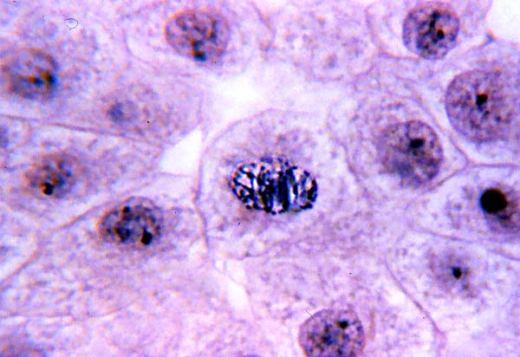

Slide 15
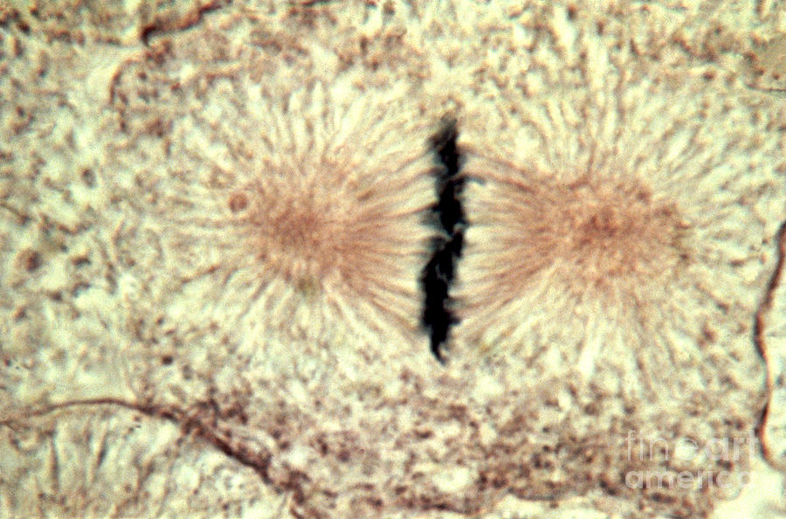

Slide 16
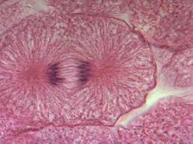

Slide 17
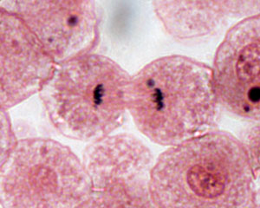

Slide 18
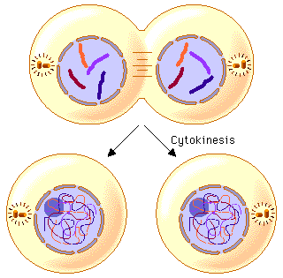
Cytokinesis
Final division of cell membrane and cytoplasm.

Slide 19
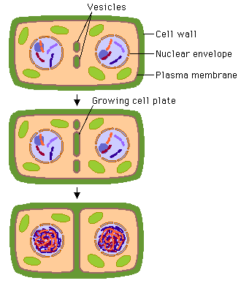
Cytokinesis
Plant cells form a CELL PLATE between two new cells. This will become part of the cell wall.

Slide 20
Cytokinesis
Animal cells form a cell membrane that pinches in to form two new cells.

Slide 21
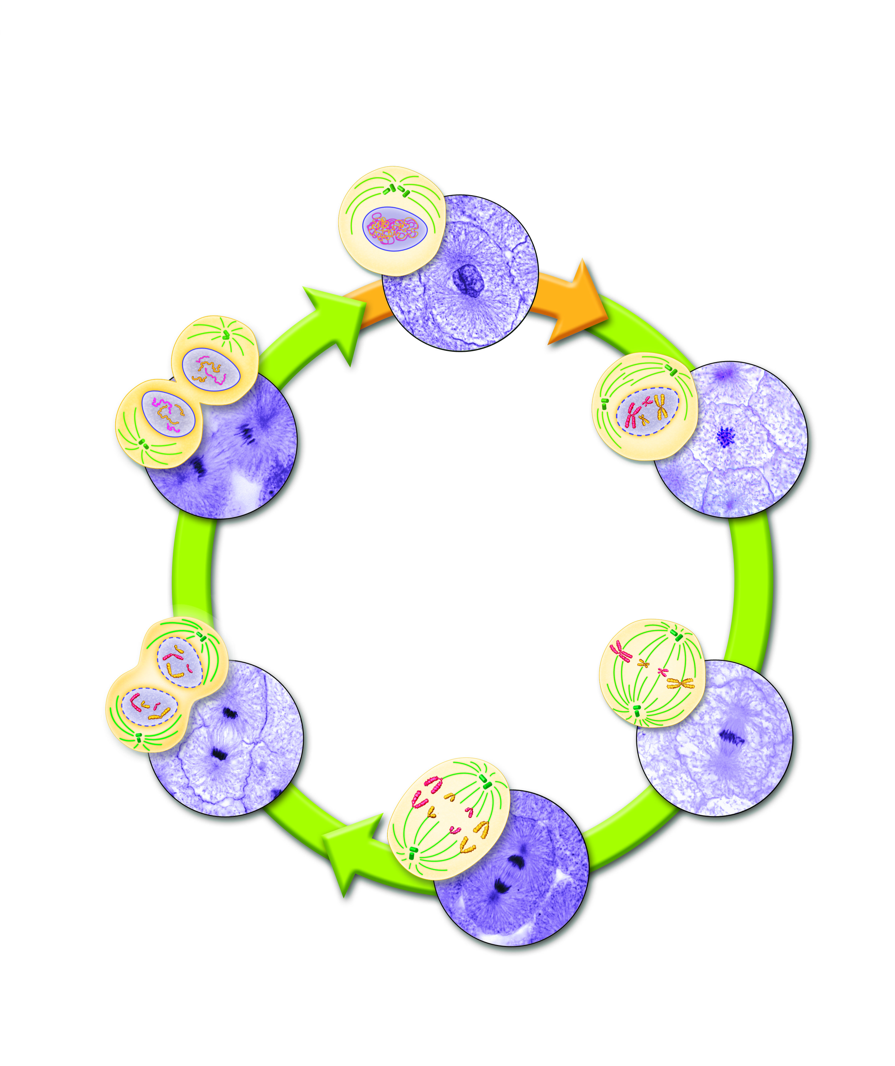

Slide 22
The cell cycle is controlled by regulatory proteins both inside and outside the cell. Growth factors stimulate growth, embryonic development, and wound healing. Apoptosis is programmed cell death. Some diseases are caused by too much cell growth, such as Parkinson’s disease and AIDS.

Slide 23
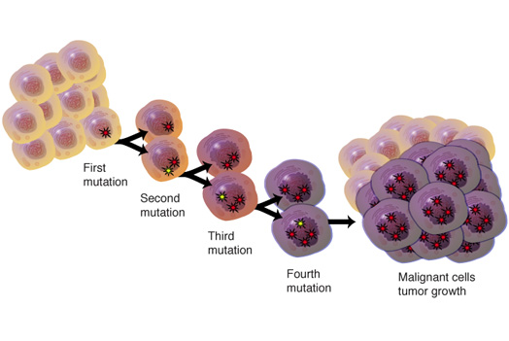
Cancer cells do not respond to the signals that regulate growth. The cells grow out of control and can cause a mass called a tumor. Benign: does not spread Malignant: invade and destroy healthy tissue

