Slide 1
DEFINE
Anatomical: of or relating to bodily structure.
Adaptation: heritable characteristics that increases an organism’s ability to survive and reproduce in an environment

Slide 2
CHAPTER 16 NOTES

Slide 3
EVOLUTION
Evolution – change over time
Evolution is a theory (a well- supported, testable explanation of phenomena that have occurred in the natural world)

Slide 4
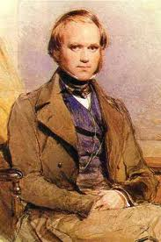
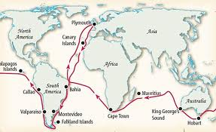
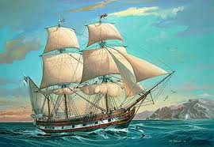
CHARLES DARWIN
Contributed more to our understanding of evolution than anyone
Journeyed around the world on the HMS Beagle and made observations and collected evidence

Slide 5
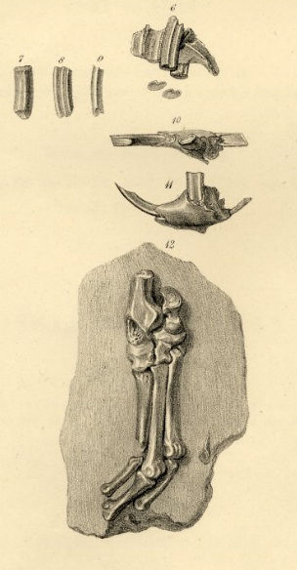
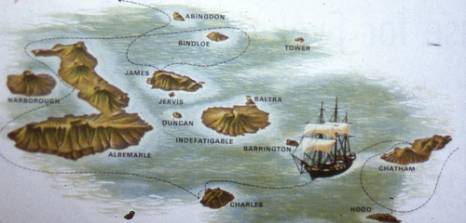
CHARLES DARWIN
Collected fossils (preserved remains of ancient organisms)
The islands that influenced Darwin the most were the Galapagos Islands (a group of islands with very different climates)

Slide 6
Other Scientists that influenced Darwin:
1. Hutton & Lyell studied geological change to show that the Earth changes over time

Slide 7
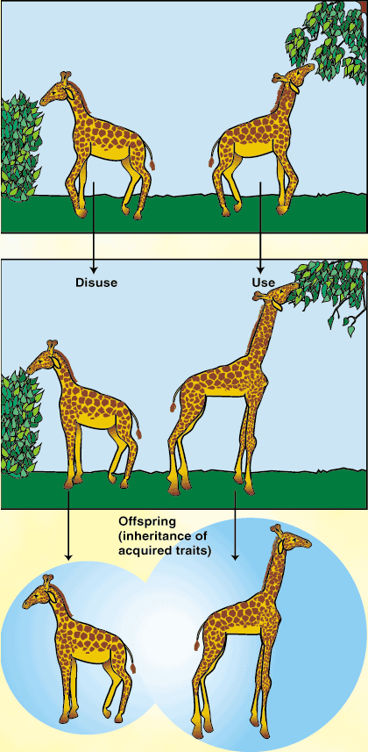
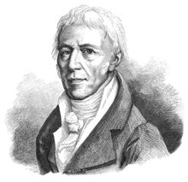
Other Scientists that influenced Darwin:
2. Lamarck was the first scientist to recognize that living things change over time

Slide 8
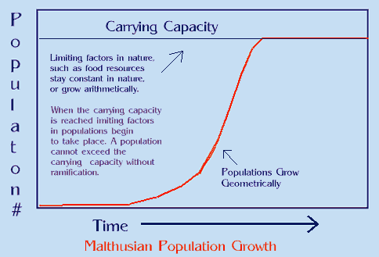
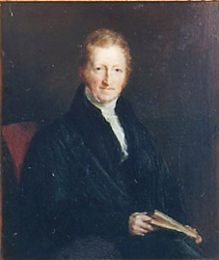
Other Scientists that influenced Darwin:
3. Malthus reasoned that if the human population continued to grow unchecked, sooner or later there would be insufficient living space and food for everyone (war, famine and disease help keep this growth in check)

Slide 9
Lamarck’s ideas:
1. Organisms constantly strive to improve themselves
2. Most-used body structures develop, but unused ones waste away
3. Once a structure is modified by use or disuse, the modification is inherited by the organism’s offspring (inheritance of acquired characteristics)
ALL OF THESE WERE PROVEN WRONG, but Lamarck paved the way for the work of later biologists.

Slide 10
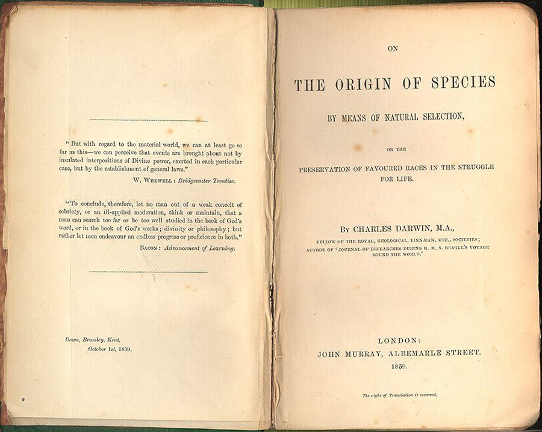
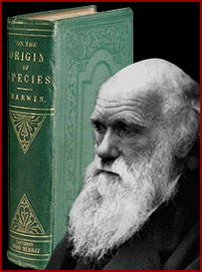
CHARLES DARWIN
In 1859, Darwin published the results of his work in a book – On the Origin of Species – in which he proposed a theory called Natural Selection

Slide 11
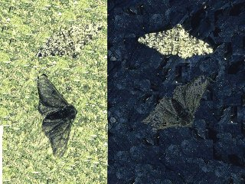
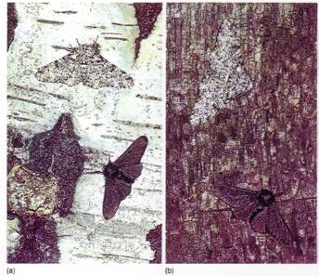
CHARLES DARWIN
Definitions:
Variation – differences between individual members of a population (ex. Color of fur, shape of teeth)
Adaptation – an inherited characteristic that increases an organism’s chance of survival

Slide 12
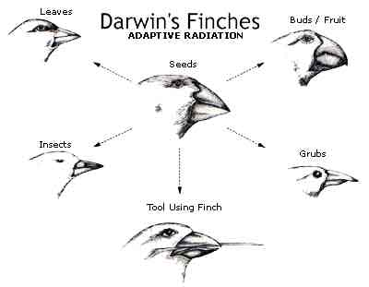

Slide 13
Darwin’s Theory of Natural Selection:
1. There is a variation within a population
2. Some variations are favorable
3. Not all young produced in each generation can survive (struggle for existence)
4. Individuals that survive and reproduce are those with favorable variations (survival of the fittest)

Slide 14
EVIDENCE OF EVOLUTION
According to evolutionary theory, all life originated from a common ancestor.
Common descent – the theory that all species were derived from common ancestors

Slide 15
WAYS TO DETERMINE HOW RELATED ORGANISMS ARE:

Slide 16
1. Fossils
The fossil record reveals changes in populations over time and supports the theory of evolution.
Scientists can calculate a fossil’s age by using radioactive dating or relative dating (we will discuss this later)
The fossil record is incomplete, but it still shows us relationships between species and how their structures have changed over time.
Fossils are mostly found in sedimentary rock.

Slide 17
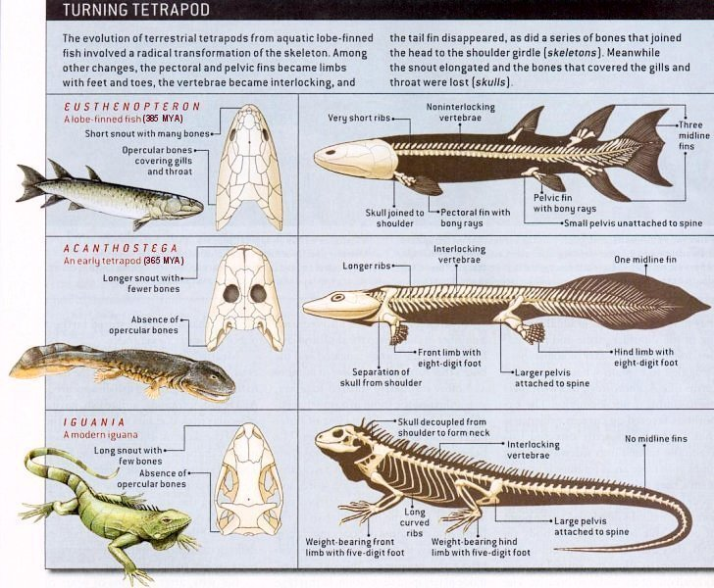

Slide 18
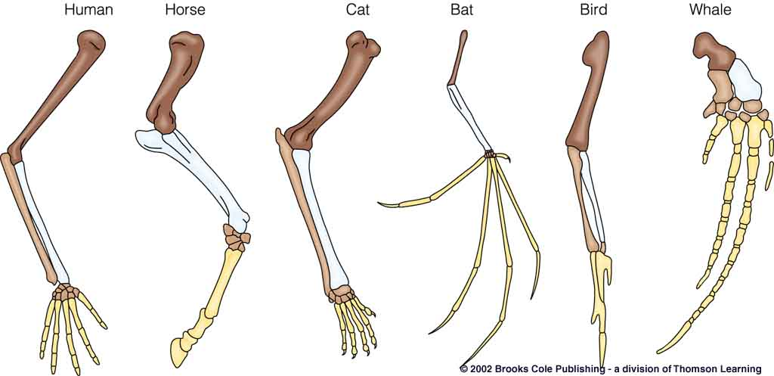
2. Homologous Structures
Homologous structures – structures that have different mature forms, but develop from the same tissues
Ex. Arms, wings, and flippers are all constructed from the same basic bones

Slide 19
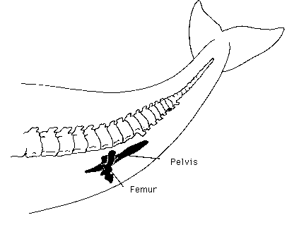
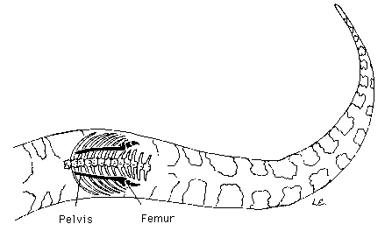
2. Homologous Structures
Vestigial structures – structures reduced in size and often unused
Ex. Leg/hip bones in pythons or appendix in humans

Slide 20
3. Embryology & Biochemistry
Embryology – compare how embryos of different species look during certain stages of development

Slide 21
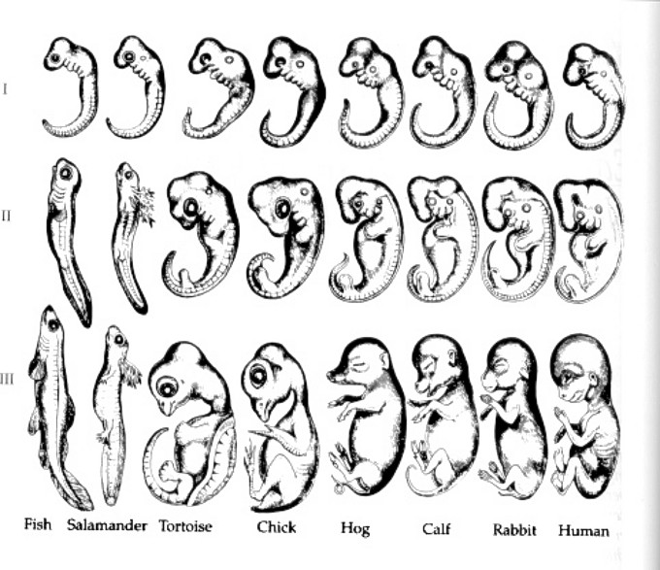
3. Embryology & Biochemistry

Slide 22
3. Embryology & Biochemistry
Biochemistry – compare the chemicals that make up our body (amino acid)

Slide 23
Phylogenetic Trees
A phylogenetic tree, or cladogram, is a branching diagram that shows evolutionary relationships among different organisms.
The closer two branches are to each other infers that the organisms on those branches are more closely related to each other.

Slide 24
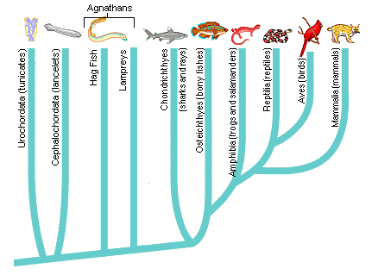
Phylogenetic Tree
Are reptiles more closely related to amphibians or birds?
BIRDS – they are on the same branch

Slide 25
Artificial Selection
Darwin observed that plant and animal breeders used variation to improve crops and livestock (ex.: fastest horses, largest fruits).
He called this process artificial selection.
In artificial selection, nature provides the genetic variation, and humans select those variations they find useful.

Slide 26
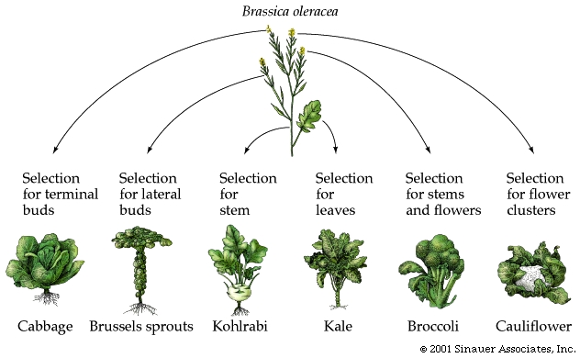
Artificial Selection in Plants
The different vegetables shown above have been developed by humans by the process of artificial selection.

Slide 27
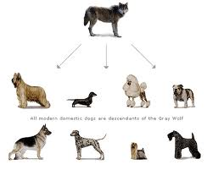
Artificial Selection in Animals
Canis lupus
Canis familiaris
All modern domestic dogs (Canis familiaris) are descendants of the gray wolf. The different breeds have been developed by humans by the process of artificial selection.

