Slide 1
Karyotypes
Objective: Learn and Identify characteristics of Karyotypes
Notes
Karyotype Activity

Slide 2
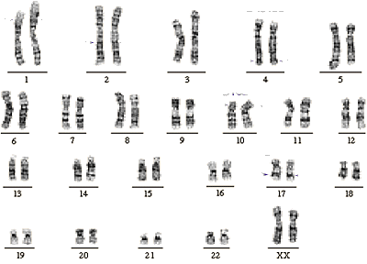
A _________________ is a “picture” of a person’s chromosomes.
Each person has ___ chromosomes, in ___ pairs.
Pairs 1-22 are called _____________________
Pair # 23 determines sex. ______= female ______ = male.

Slide 3
A karyotype is a “picture” of a person’s chromosomes.
Each person has ___ chromosomes, in ___ pairs.
Pairs 1-22 are called _____________________
Pair # 23 determines sex. ______= female ______ = male.

Slide 4
A karyotype is a “picture” of a person’s chromosomes.
Each person has 46 chromosomes, in 23 pairs.
Pairs 1-22 are called ______________
Pair # 23 determines sex. ______= female ______ = male.

Slide 5
A karyotype is a “picture” of a person’s chromosomes.
Each person has 46 chromosomes, in 23 pairs.
Pairs 1-22 are called Autosomes
Pair # 23 determines sex. ______= female ______ = male.

Slide 6
A karyotype is a “picture” of a person’s chromosomes.
Each person has 46 chromosomes, in 23 pairs.
Pairs 1-22 are called Autosomes
Pair # 23 determines sex. X= female Y= male.

Slide 7
What is this person’s sex? ______________

Slide 8
What is this person’s sex? female

Slide 9
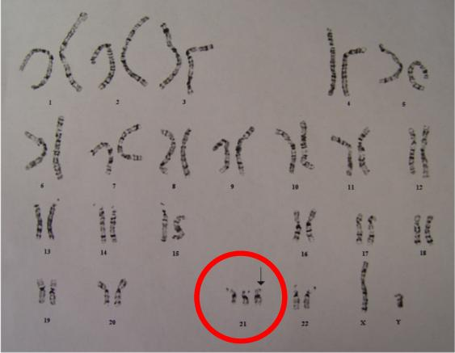
If a person is either missing a chromosome, or has an extra chromosome, the result will be a ____________.
A missing chromosome is called _____________
because only one is left.
An extra chromosome is called _________because there are 3.
This person has _ which results in Down syndrome.

Slide 10
If a person is either missing a chromosome, or has an extra chromosome, the result will be a mutation.
A missing chromosome is called _____________
because only one is left.
An extra chromosome is called _________because there are 3.
This person has _ which results in Down syndrome.

Slide 11
If a person is either missing a chromosome, or has an extra chromosome, the result will be a mutation.
A missing chromosome is called monosomy.
because only one is left.
An extra chromosome is called _________because there are 3.
This person has _ which results in Down syndrome.

Slide 12
If a person is either missing a chromosome, or has an extra chromosome, the result will be a mutation.
A missing chromosome is called monosomy.
because only one is left.
An extra chromosome is called trisomy because there are 3.
This person has _ which results in Down syndrome.

Slide 13
If a person is either missing a chromosome, or has an extra chromosome, the result will be a mutation.
A missing chromosome is called monosomy.
because only one is left.
An extra chromosome is called trisomy because there are 3.
This person has trisomy 21 which results in Down syndrome.

