Slide 1
Genetics
GENETICS

Slide 2
Gregor Mendel
Known as the Father of Genetics
Spent 14 years in a monastery
Was in charge of the monastery garden
His work in the garden played an important role in biological inheritance.
Mendel used pea plants to study genetics.

Slide 3
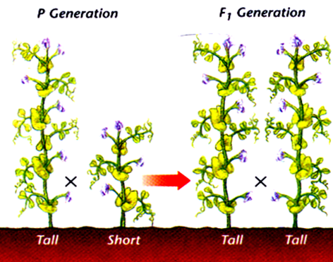
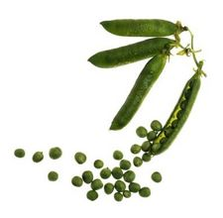
Pea Plants
The pea plants were “true breeding” meaning they self-pollinate and produce identical offspring.
Mendel studies traits like tall or short height and green, or yellow seeds.

Slide 4
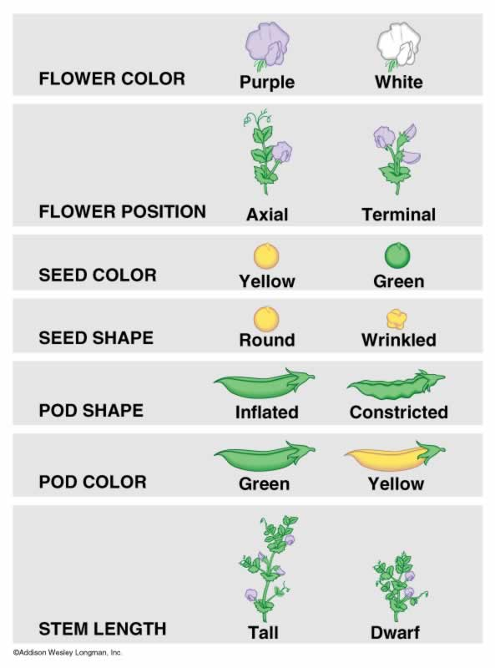
This is some of the possible traits that can traced in the pea plants.

Slide 5
Genetic Terms

Slide 6
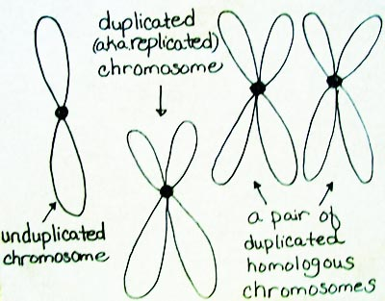

Slide 7
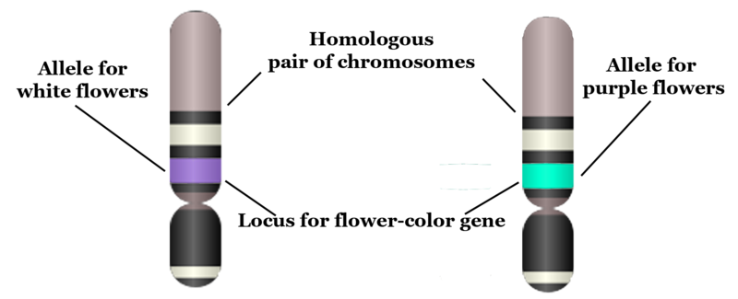
Gene
Unit of inheritance that usually is directly responsible for one character or trait.
Ex: The gene for height

Slide 8
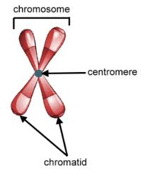
Chromosome
Threadlike structure within the nucleus containing the genetic information that is passed from one generation to the next.
Humans have 46 chromosomes in each of their cells.

Slide 9
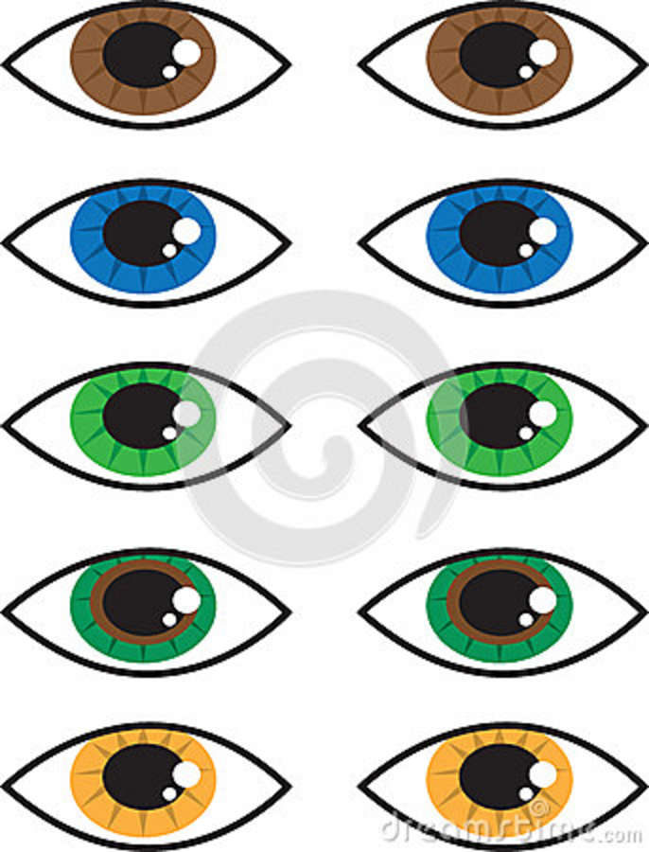
Allele
One of a number of different forms of a gene.
Gene: Eye color
Alleles: Blue, brown, green

Slide 10
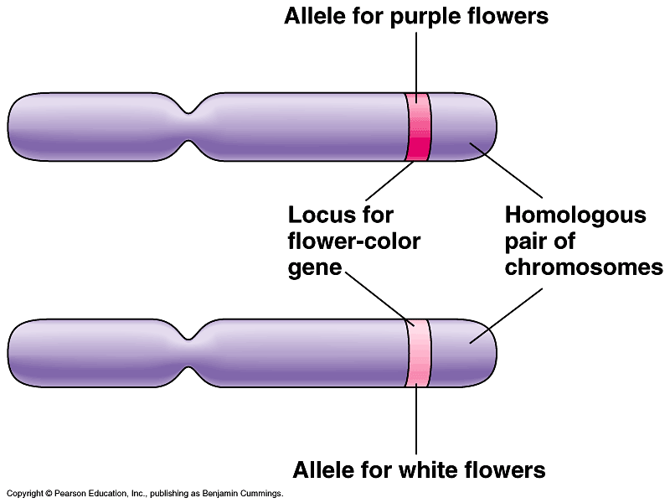
P
p

Slide 11
Match these in your head, be ready to share.
a. Threadlike structures made of DNA found in nucleus
b. Unit of inheritance
c. One form of a gene
Gene
Chromosome
Allele

Slide 12
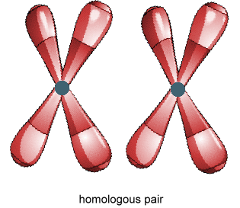
Homologous Chromosomes
Corresponding chromosomes from the opposite-sex parent.

Slide 13
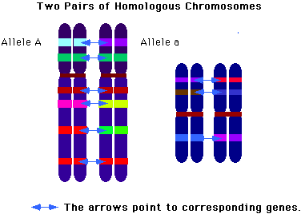

Slide 14
Homozygous
Term used to refer to an organism that has two identical alleles for a particular trait.
Ex. TT, hh, rr, BB

Slide 15
Heterozygous
Term used to refer to an organism that has two different alleles for a particular trait.
Ex. Rr, Gg, Hh, Bb

Slide 16
Dominant
An allele that is fully expressed in an organism’s appearance.

Slide 17
Recessive
An allele that has no noticeable effect on an organism’s appearance.

Slide 18
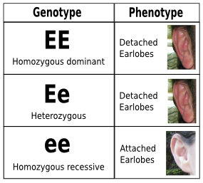

Slide 19
Dominant Traits RULE
Strong Hereditary traits cover weak traits.
Mendel called stronger traits DOMINANT
Dominant traits are represented by capital letters T
Mendel called weaker traits recessive
recessive traits are represented by lower case letters t

Slide 20
Genotype
Genetic makeup of an organism
Ex. RR, Bb, tt

Slide 21
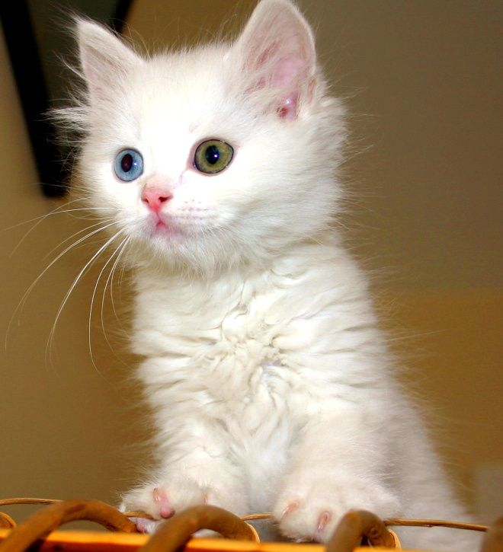
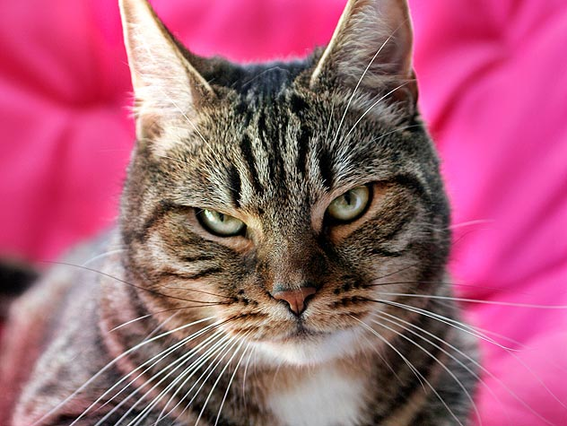
Phenotype
physical characteristics of an organism

Slide 22
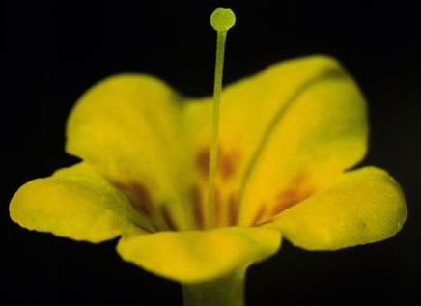
YY
Phenotype?
Genotype?
Homozygous or Heterozygous?

Slide 23
YY
Phenotype? YELLOW FLOWERS
Genotype? Y Y
Homozygous or Heterozygous?
The letters are the same so…….
HOMOZYGOUS

Slide 24
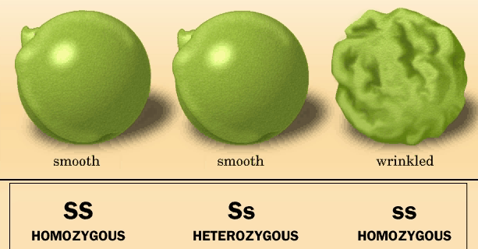
Phenotype
Genotype

Slide 25
Punnett Squares and Probablility
A Punnett square is a simple graphical way of predicting all of the potential combinations of genotypes that can occur in the offspring, given the genotypes of the parents.
It is used to determine the probability of genotypes, which determines the phenotypes.
Probability can be expressed as a ratio, fraction or percent.
Example: 3:1 or 3/4 or 75%

Slide 26
To set up a Punnett square, you first draw a 4-square grid:

Slide 27
Next, you put the alleles of one parent across the top and those of the other parent down the left side (law of segregation).
For example, if parent genotypes were RR (round peas) and rr (wrinkled peas), the setup would be:
r
r
R
R

Slide 28
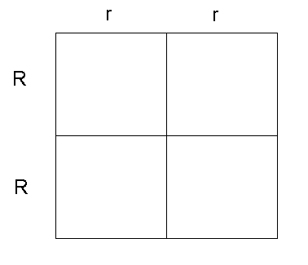
Next, fill in the boxes by copying the row and column-head letters across or down into the empty squares.

Slide 29
Next, fill in the boxes by copying the row and column-head letters across or down into the empty squares.

Slide 30
The Results
The genotype is 4 Rr, which is 4/4 or 100% Rr.
The phenotype is 4 round, which is 4/4 or 100% round.
r
r
R
Rr
Rr
round
round
Rr
Rr
R
round
round

