Slide 1
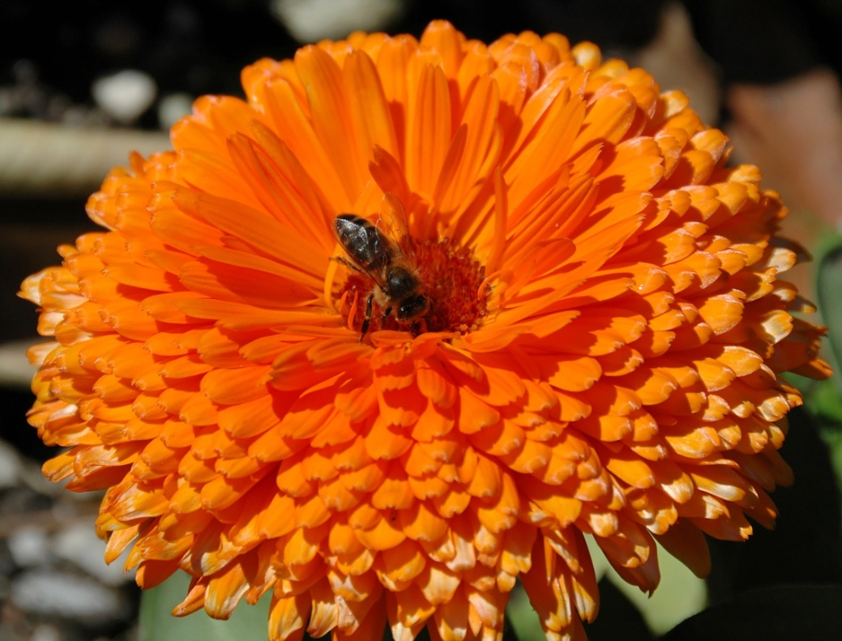
Reproduction in Flowering Plants

Slide 2
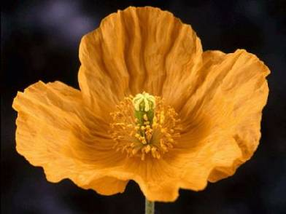
The Parts of a Flower
Most flowers have four parts:
sepals
petals
stamens
carpels

Slide 3
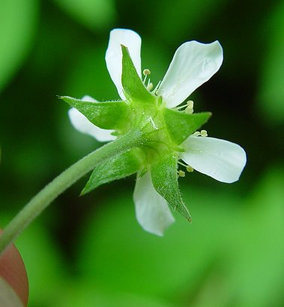
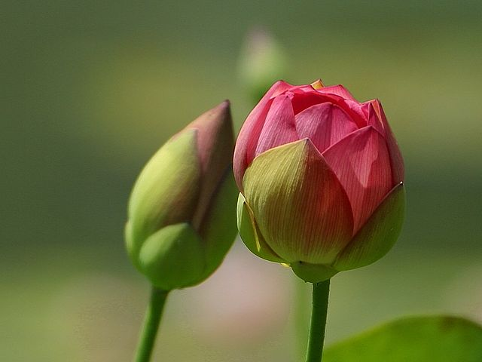
The Parts of a Flower
Sepals :protect the bud until it opens.

Slide 4
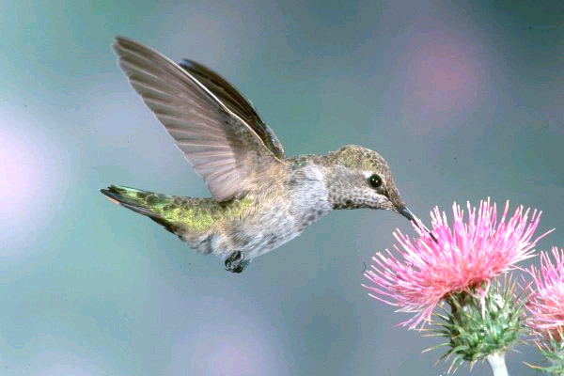
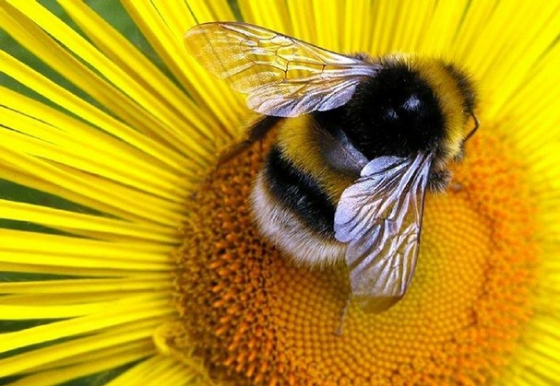
The Parts of a Flower
Petals : attract insects and other pollinators.

Slide 5
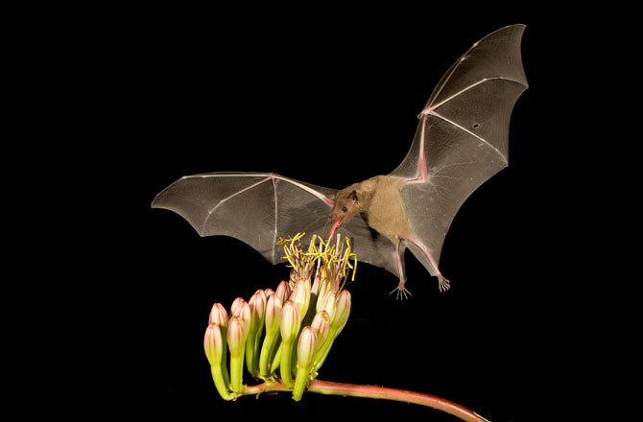
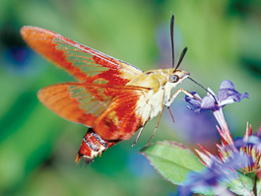
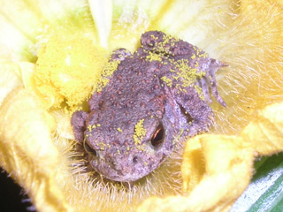
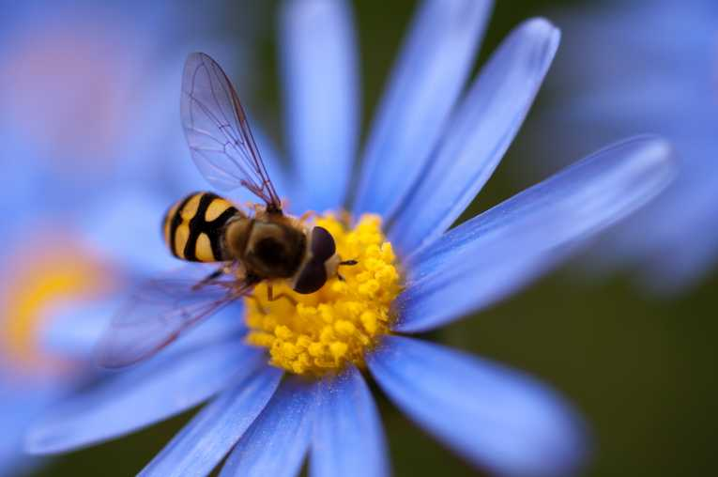

Slide 6
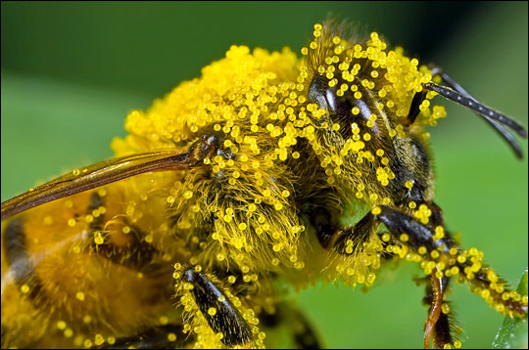
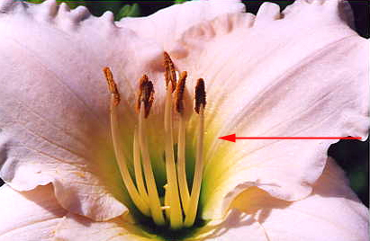
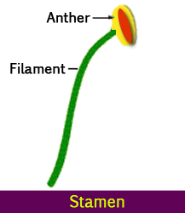
The Parts of a Flower
Stamen: make pollen (male gamete).

Slide 7
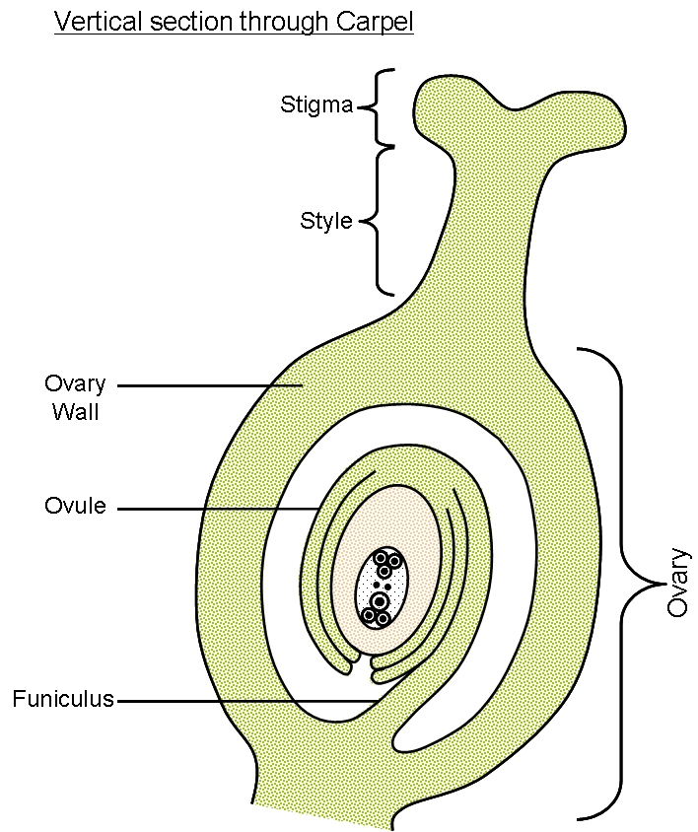
The Parts of a Flower
Pistil (Carpel): grow into fruits which contain the seeds.

Slide 8
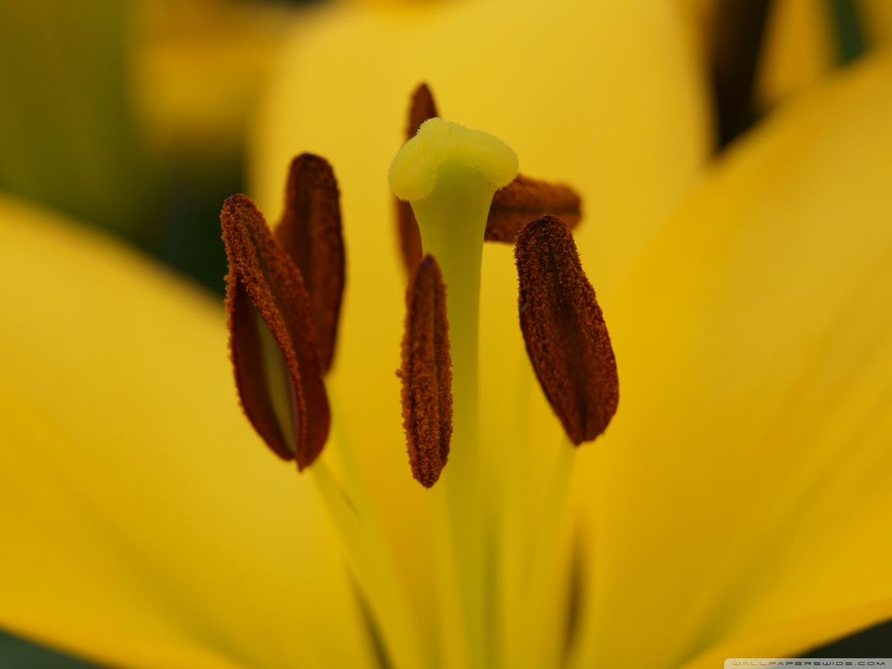

Slide 9
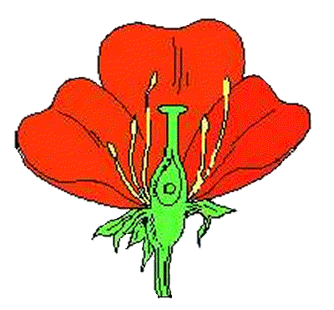
Parts of a Flower
PETALS
STAMEN
PISTIL
SEPAL

Slide 10
The parts of a flower
Petals
Stamens
Carpels

Slide 11
Stamen (male)
Stamen have 2 parts.
1. Anther: pollen grains grow on the anther.
When the grains are fully grown, the anther splits open.
2. Filament- supports the anther

Slide 12
Pistil/Carpel (female)
Stigma- pollen sticks here
Style- supports the stigma
Ovary- protects the eggs.
Ovules (eggs)

Slide 13
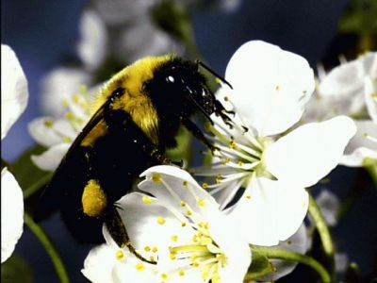
Pollination
Transfer pollen from the male (stamen) to the female (stigma) part of the flower.
Pollination can be assisted by insects, bats, birds or mammals.

Slide 14
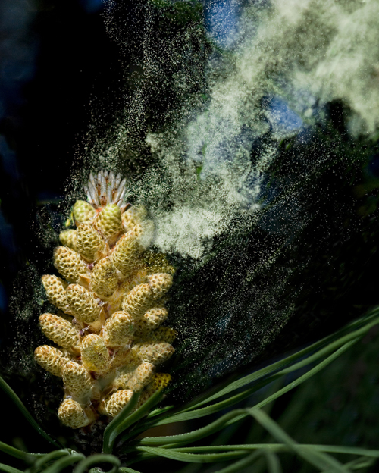
Pollination
Some flowers, do not have brightly colored flowers and nectar to attract insects.
These flowers are pollinated by wind or water.

Slide 15
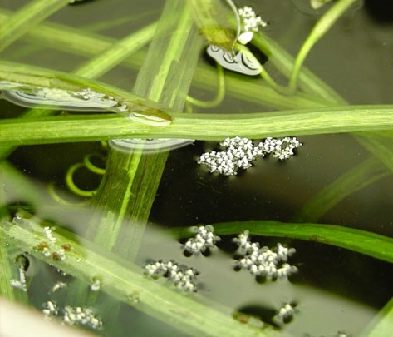
Water pollination

Slide 16
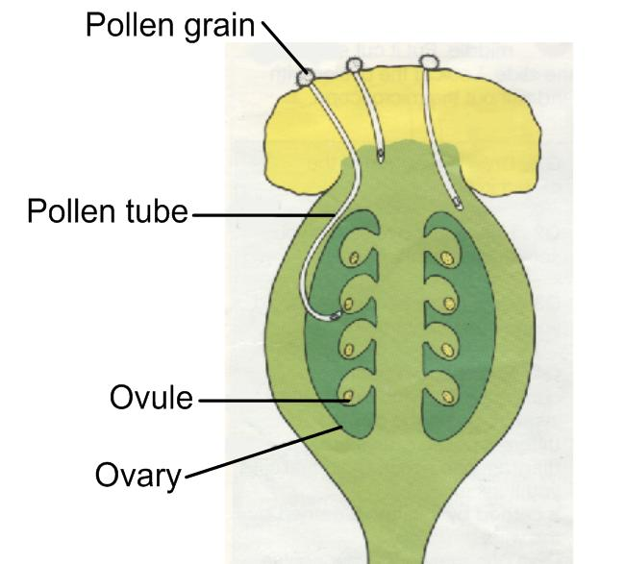
Fertilization
Pollen grains germinate on the stigma.
A pollen tube grows down the style to reach an ovule.
Fertilized ovules develop into seeds.

Slide 17
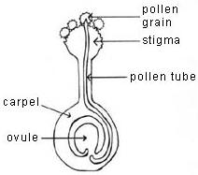

Slide 18
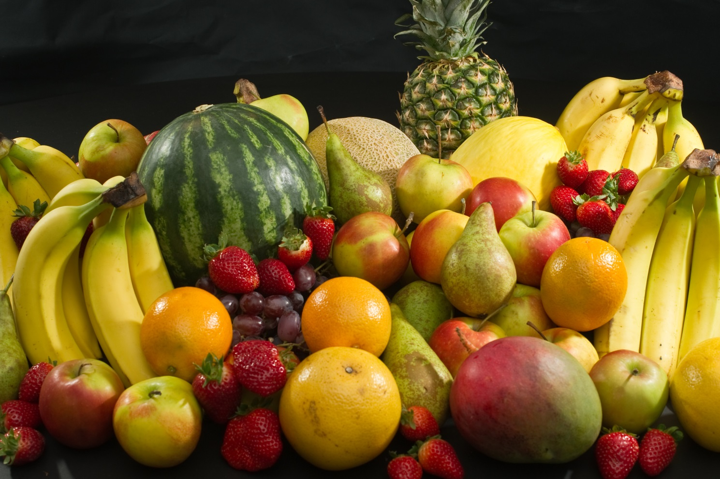
Fertilization cont.
The ovary enlarges to form fruit and to protect the seeds.

Slide 19
