Slide 1
DNA Replication Notes

Slide 2
When new cells are made, the DNA must be copied. This is called _______________________.

Slide 3
When new cells are made, the DNA must be copied. This is called replication.

Slide 4
During replication, DNA ______________________________ (sides). Each strand serves as a _____________________(model) for a new strand.
___________________________ – enzyme that is involved in DNA replication
it “_________________________” the template strand so that the correct new strand is created.

Slide 5
During replication, DNA separates into 2 strands (sides). Each strand serves as a _____________________(model) for a new strand.
___________________________ – enzyme that is involved in DNA replication
it “_________________________” the template strand so that the correct new strand is created.

Slide 6
During replication, DNA separates into 2 strands (sides). Each strand serves as a template (model) for a new strand.
___________________________ – enzyme that is involved in DNA replication
it “_________________________” the template strand so that the correct new strand is created.

Slide 7
During replication, DNA separates into 2 strands (sides). Each strand serves as a template (model) for a new strand.
DNA polymerase – enzyme that is involved in DNA replication
it “_________________________” the template strand so that the correct new strand is created.

Slide 8
During replication, DNA separates into 2 strands (sides). Each strand serves as a template (model) for a new strand.
DNA polymerase – enzyme that is involved in DNA replication
it “proof reads” the template strand so that the correct new strand is created.

Slide 9
Why must DNA replicate?
46
46
46

Slide 10
Definition of Replication
Replication is the copying of DNA

Slide 11
Steps of Replication
Step 1:
Unzipping – Helicase enzymes unwind DNA to make replication forks - sites at which separation and replication of DNA occurs

Slide 12
Steps of Replication
Step 1 (Picture):
A - T
T - A
C - G
G C
A T
G C Helicase unzips
G C DNA

Slide 13
Steps of Replication
Step #2: Stabilization
Single-stranded binding proteins prevent separated DNA strands from rejoining

Slide 14
Steps of Replication
Step #2 (Picture):
A - T T Free DNA
T – A A nucleotides
C – G G floating in
G – C C the nucleus
A A - T
G G – C
G G - C
G
A
C
T
G
G
A

Slide 15
Steps of Replication
Step #3: Priming
Primase – enzyme that makes an RNA primer during DNA replication
Attach to first exposed bases and lay short sections of RNA

Slide 16
Steps of Replication
Step #4:Elongation
Free-floating nucleotides pair to complimentary bases on exposed DNA
DNA polymerase – the enzymes which bond nucleotides together in DNA replication

Slide 17
Steps of Replication
Five-prime (5’) and three-prime (3’) ends – opposite ends of a single DNA strand
Antiparallel – a DNA molecule that fits together but runs in opposite directions

Slide 18
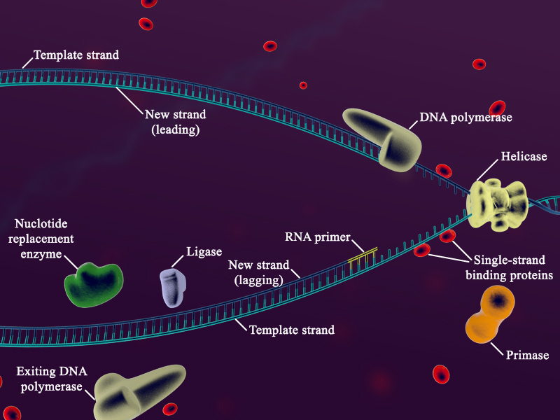
Steps of Replication
Leading strand:
Assembled 5’ to 3’, or toward replication fork
Nucleotides added continuously to 3’ end
Lagging strand:
Assembled 3’ to 5’, or away from replication fork
Okazaki fragments – a series of short segments of DNA synthesized on the lagging strand during DNA replication

Slide 19
Steps of Replication
Step #5: Sealing
DNA replacement complexes remove RNA primers
Ligase – enzyme that binds segments of the new DNA strand together

Slide 20
Steps of Replication
Step #5: (Picture)
A - T A – T
T – A T - A 2 identical
C – G C - G strands of
G – C G – C DNA
A - T A - T
G - C G – C
G - C G – C
parent new new parent

Slide 21
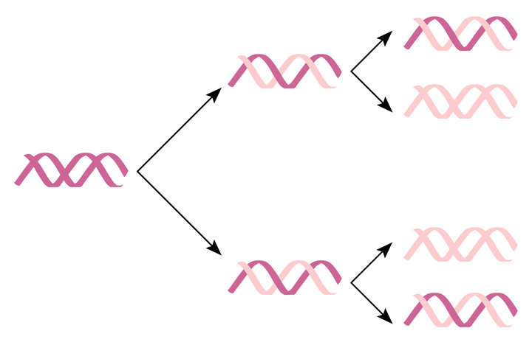
Semiconservative Replication
Process of DNA replication that produces one original strand and one newly created strand

