Slide 1
Reproduction
Biology 2017

Slide 2
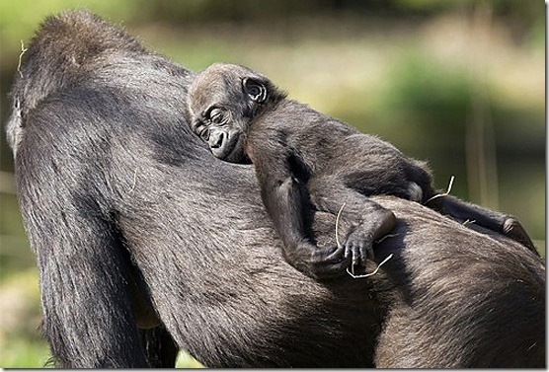
Reproduction Strategies
Living organisms have the ability to reproduce, which allows them to pass traits to future generations.
Reproduction falls into two categories: sexual and asexual.

Slide 3
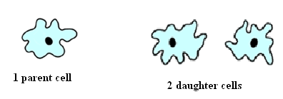
Asexual Reproduction
Involves one parent and results in offspring that are identical to the parent.
There are 3 main methods of asexual reproduction.
Prokaryotic bacteria reproduce by fission. The result is two genetically identical daughter cells.

Slide 4
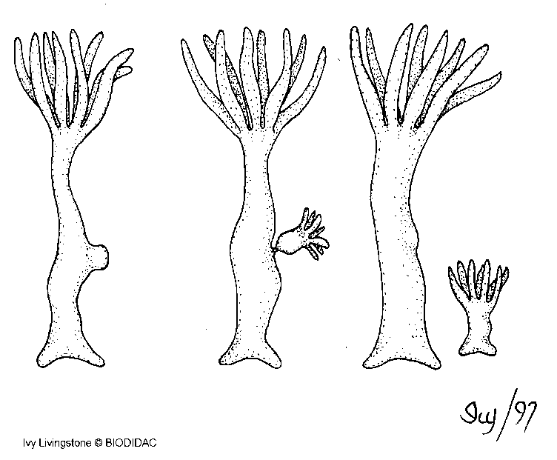
Asexual Reproduction
Budding
Fragmentation and regeneration:
Type of asexual reproduction where a parent replicates to produce a clone that splits off from the parent body.
Types of asexual reproduction that allows some organisms to reproduce body parts from incomplete fragments of the parent body.

Slide 5
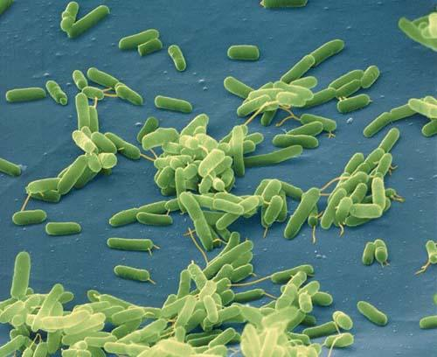
Advantages of asexual reproduction
A single organism can increase a population
Energy is conserved (no searching for mates)
Populations can multiply rapidly !

Slide 6
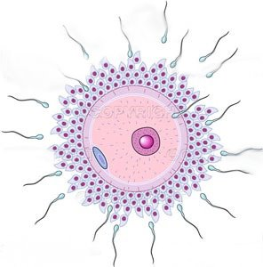
Sexual Reproduction
Sexual reproduction involves two parents.
The union of two genetically different sex cells (gametes) each carrying half the amount of necessary DNA to form a zygote.
The zygote is the fertilized cell that will grow into the offspring.

Slide 7
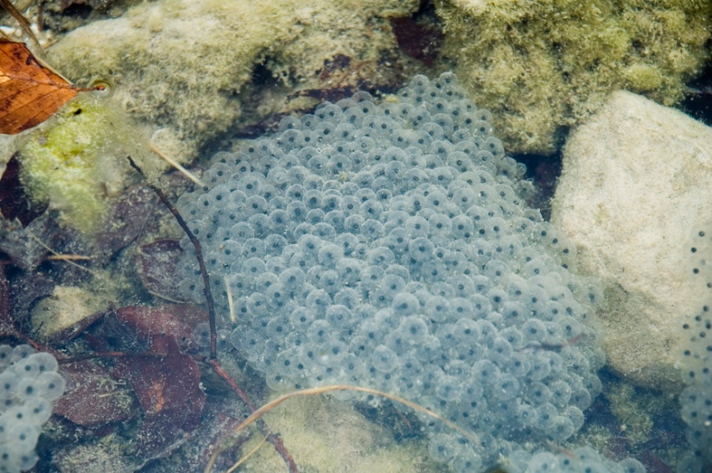
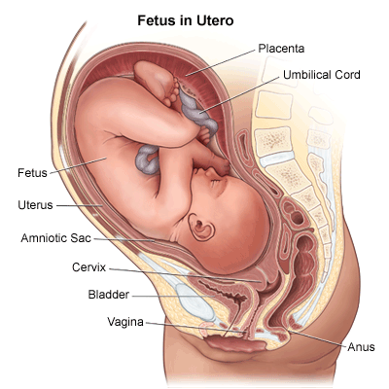
Types of sexual reproduction: These are characterized by where fertilization takes place.
External fertilization
Internal fertilization
Examples: fish and frogs
Must occur in water; Females will excrete eggs and males will eject sperm onto the eggs in the water.
Examples: birds and reptiles
Females will lay fertilized eggs which are protected by a shell. Mammals will keep the fertilized egg within the body.

Slide 8
Advantages of sexual reproduction:
Sexual reproduction allows for different gene (DNA) combinations which can increase the chances of survival for a species.

Slide 9
Review: What process makes gametes?
MEIOSIS!
Are the cells haploid or diploid?
HAPLOID!

Slide 10
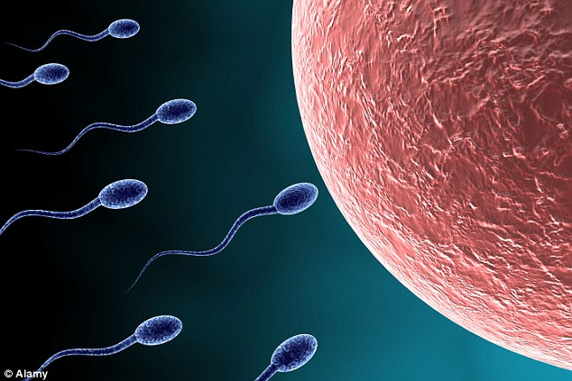
What are the 2 kinds of gametes?
Eggs and Sperm

Slide 11
How are gametes different than somatic cells?

Slide 12
How are somatic different than gamete cells?
Somatic Cells
Diploid number of chromosomes (humans 46)
Body cells (skin cells, heart cells)
Gametes
Haploid number of chromosomes (humans 23)
Sex cells (eggs and sperm)

Slide 13
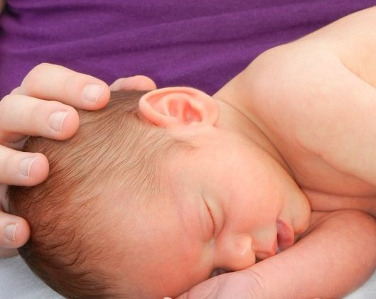
Human Reproduction
Notes:
Newborn Rylan Cobb ☺

Slide 14
Puberty – a period of rapid growth and sexual maturation during which the reproductive system becomes fully functional. This usually occurs between the ages of 9-15.
Males will begin to produce larger amounts of testosterone.
Females will begin to produce larger amounts of estrogen.

Slide 15
Gonads are the body’s reproductive glands. They produce gametes and secrete sex hormones.
Female gonad – ovaries
Male gonads - testes

Slide 16
Male Reproductive System
The main function is to produce and deliver sperm.
• Testes – make sperm
• Scrotum – holds testes away from the body to keep optimal temperature
• Epididymis – stores sperm
• Vas Deferens – tube that transports sperm to the urethra
• Urethra – tube that carries sperm through the penis and outside the body
• Penis – male reproductive organ
• Male reproductive glands – seminal vesicles, bulbourethral glands, and prostate all help produce seminal fluid which nourishes and protects sperm on their way to the vagina

Slide 17
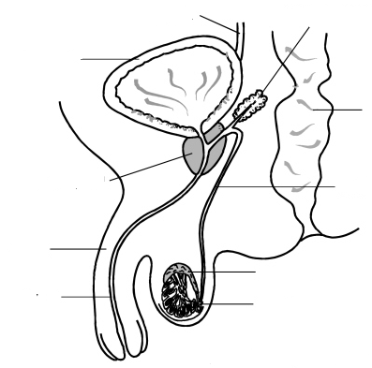
Seminal vesicle – produces a nutrient liquid that is mixed with sperm during ejaculation.
Ureter
Bladder
Rectum
Prostate gland – produces testosterone
Vas Deferens – tube that transports sperm to the urethra.
Penis
Epididymus – place where sperm mature and are stored.
Urethra – throughway for both sperm and urine
Testes – produce sperm

Slide 19
Female Reproductive System
The main function is to produce ova (egg) and to prepare the body to nourish a developing embryo.
• Ovaries – make eggs
• Fallopian tubes – carry eggs to the uterus
• Uterus – the “womb”; holds the developing baby
• Cervix – the opening between the uterus and the vagina; remains closed during pregnancy and dilates during labor and delivery to allow the baby to be born
• Vagina – canal that leads from the uterus to outside the body; it directs sperm to the egg

Slide 20
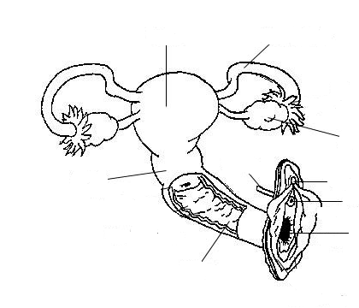
Uterus – houses the fetus during development. Fertilization happens here.
Fallopian Tube – tube in which the mature egg travels from the ovary to the uterus.
Ovary – produces the ova (egg)
Cervix – the lower end of the uterus. It dialates (expands) during child birth.
urethra
Urethral opening
Vaginal opening
Vagina

Slide 21
Egg Production
Females are born with thousands of immature eggs (primary follicles), of which only about 400 will mature and be released. Approximately every 28 days, an egg is released.

Slide 22
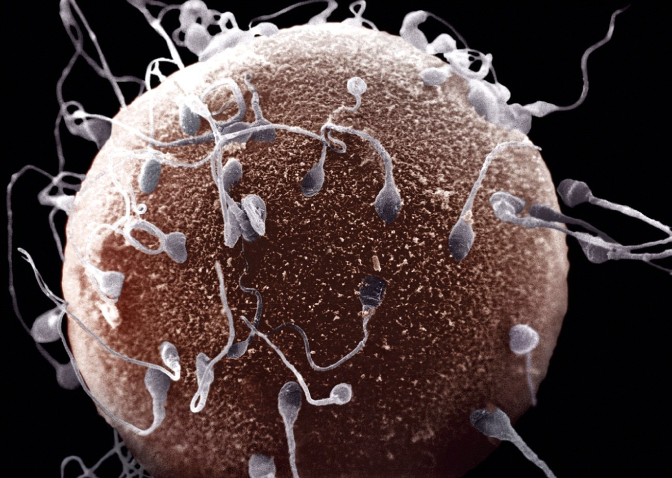
Fertilization – when the sperm and egg meet and form a new cell. The new cell is called a zygote.

Slide 23
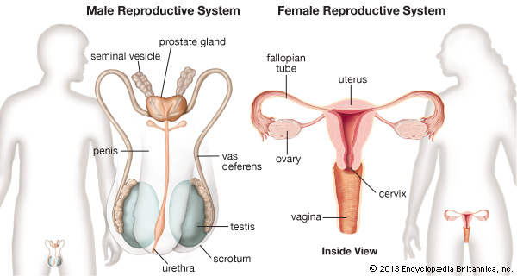

Slide 24
How Fertilization Occurs
A mature egg ruptures from the ovaries and then travels through one of the fallopian tubes. Here the egg is fertilized by the sperm forming a zygote. After about six or seven days, the embryo attaches to the wall of the uterus. The embryo will remain in the uterus for about nine months or until the contractions of the uterus force the baby out of the body.

Slide 25
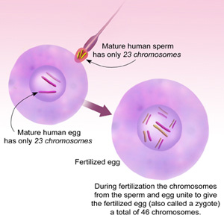
What is another name for the fertilized ovum?

Slide 26
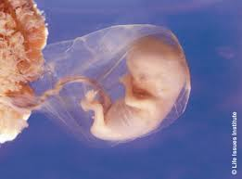
Embryo – an organism in the early stages of development

Slide 27
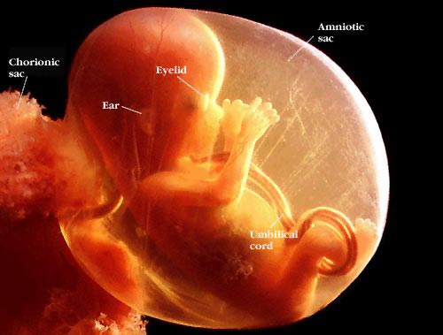
Fetus – the name given to an embryo after
8 weeks of development.

Slide 28
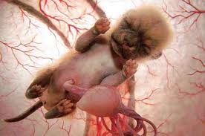
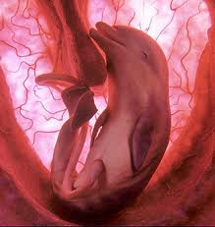
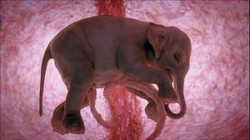

Slide 29
Menstruation- if the egg is not fertilized it will begin to break down. The lining of the uterus will begin to detach and will be discharged through the vagina.

