Slide 1
RNA

Slide 2
DNA RECAP
DNA:
DEOXYRIBONUCLEIC ACID
MAIN JOB:
STORES GENETIC INFORMATION
TRANSMITS GENETIC INFO FROM ONE GENERATION TO THE NEXT
DNA CONTROLS THE PRODUCTION OF PROTEINS WITHIN THE CELL

Slide 3
DNA RECAP CONTINUED
WHAT MAKES UP DNA?
NUCLEOTIDES
PHOSPHATE
DEOXYRIBOSE SUGAR
NITROGEN BASE
ADENINE
THYMINE
CYTOSINE
GUANINE

Slide 4
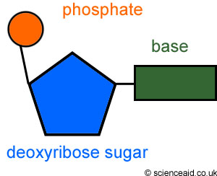
NUCLEOTIDE

Slide 5
DNA STRUCTURE
DOUBLE HELIX: TWISTED LADDER
C pairs with __G__
__A__ pairs with __T__

Slide 6
RNA
RIBONUCLEIC ACID
MAIN JOB:
CODE FOR PROTEINS
ASSEMBLES AMINO ACIDS INTO PROTEINS

Slide 7
RNA CONTINUED
WHAT MAKES UP RNA?
NUCLEOTIDES
PHOSPHATE
RIBOSE SUGAR
NITROGEN BASE
ADENINE
URACIL
GUANINE
CYTOSINE

Slide 8
RNA STRUCTURE
SINGLE STRANDED
C pairs with __G__
__A__ pairs with __U__

Slide 9
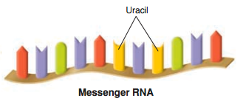
3 TYPES OF RNA
MESSENGER RNA (mRNA) : takes messages from the DNA to the rest of the cell.

Slide 10
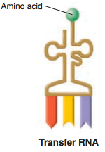
3 TYPES OF RNA CONTINUED
TRANSFER RNA (tRNA) : transfers each amino acid to the ribosome

Slide 11
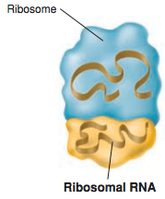
3 TYPES OF RNA CONTINUED
RIBOSOMAL RNA (rRNA) : makes the ribosomes

Slide 12
DNA AND RNA
DEOXYRIBONUCLEIC ACID
RIBONUCLEIC ACID

Slide 13
Amoeba Sisters
https://youtu.be/0Elo-zX1k8M

